Slide 1
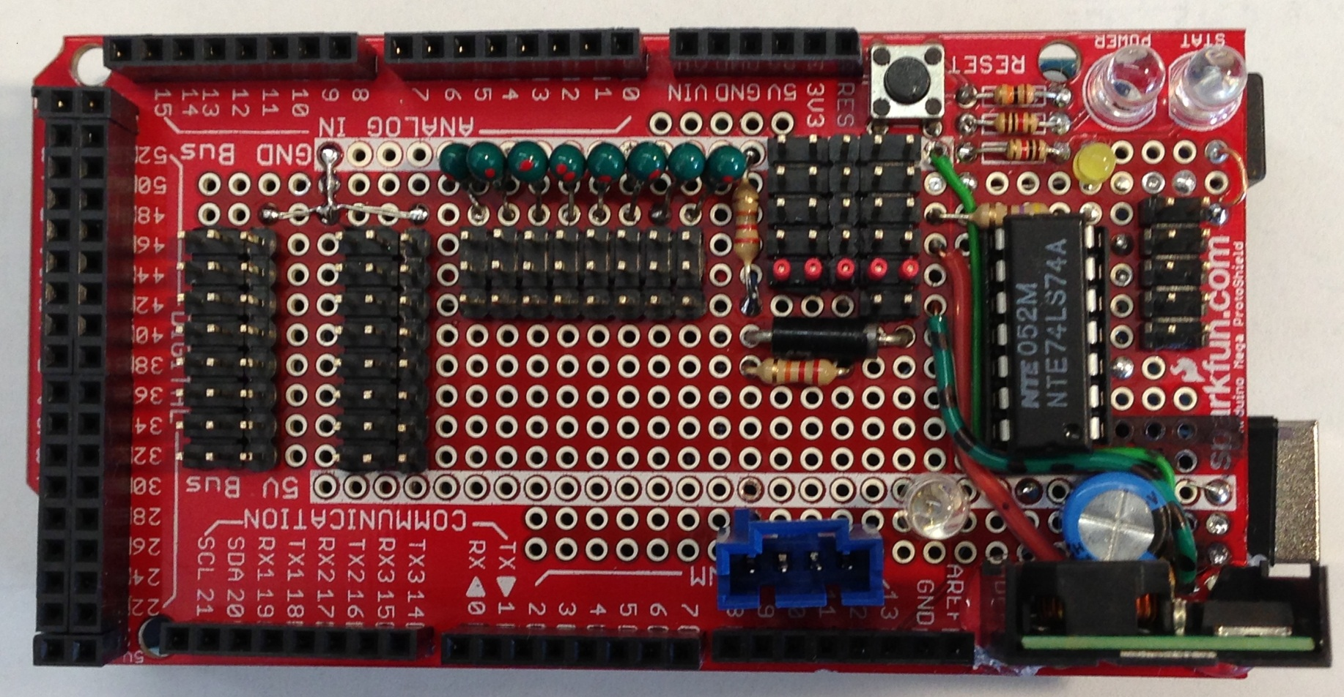

22:PA0: IR Front-L
23:PA1: IR Front-R
24:PA2: N/C Cliff-L
25:PA3: N/C Cliff-R
26:PA4: IR Rear-L
27:PA5: IR Rear-R
28:PA6: PIR-L
29:PA7: PIR-R
30:PC7: Front
31:PC6: Rear
32:PC5: Left
33:PC4: Right
34:PC3:
35:PC2:
36:PC1:
37:PC0:
Bumpers
+5vS Sensor 1.5A Regulator
Status to PC p14 blue LED
To Relay Board
BlueSmirf
BRW
BRW
A0: Sensor?
22
23
24
25
26
27
28
29
30
31
32
33
34
35
36
37
Head
R Arm
L Arm
A1
A2
A3
A4
A5
A6
A7
Wheel Odometer Inputs
+8v
key
W R B
+5S
Test Probe Ground
SCL
SDA
GND
Power In
Heartbeat p13 green
+5v Power red
+5S Sensor Power yellow
Digital Inputs
Port A
Digital Inputs
Port X
22:AD0: IR0 Side-L
23:AD1: IR1 Front-L
24:AD2: IR2 Head
25:AD3: US Head
26:AD4: IR9 Front-R
27:AD5: IR10 Side-R
28:AD6:
29:AD7:
I2C Expansion
Analog Inputs
Arduino Interface Board
Wire Colors: BRW = Black, Red, White

Slide 2
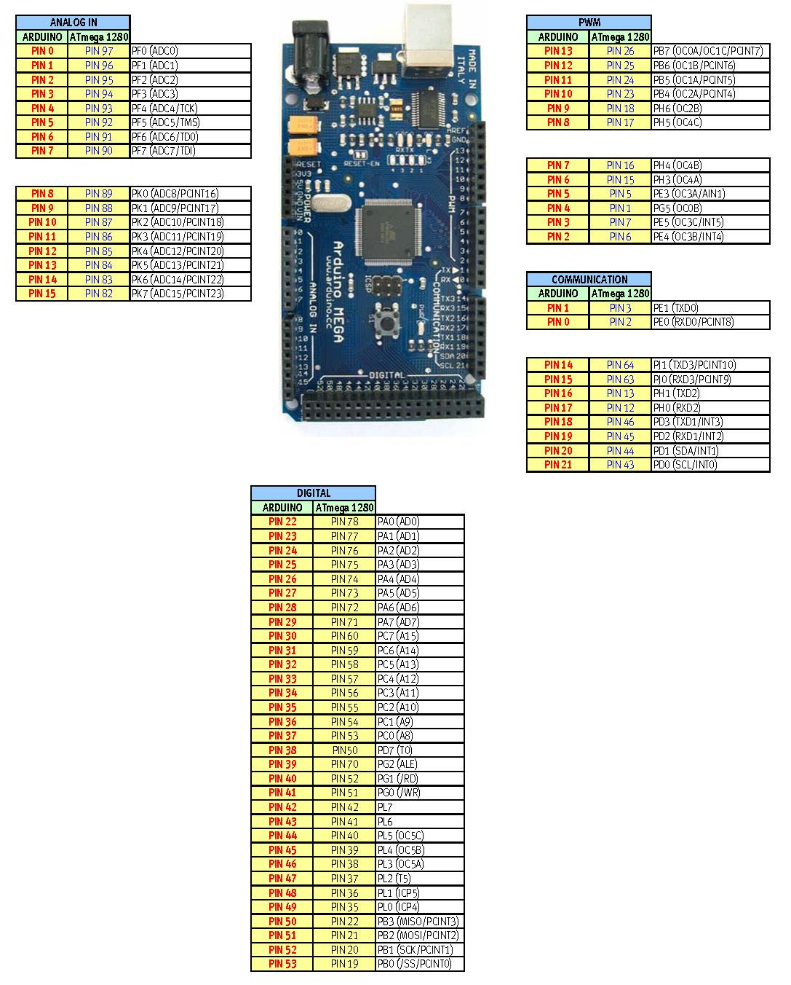
Arduino Mega Ports from: http://arduino.cc/forum/index.php/topic,95654.0.html

